Slide 1
Week 6
Visualization with seaborn

Slide 2
An introduction to seaborn
Seaborn is a library for making statistical graphics in Python. It builds on top of matplotlib and integrates closely with pandas data structures.
Seaborn helps you explore and understand your data. Its plotting functions operate on dataframes and arrays containing whole datasets and internally perform the necessary semantic mapping and statistical aggregation to produce informative plots. Its dataset-oriented, declarative API lets you focus on what the different elements of your plots mean, rather than on the details of how to draw them.
Here’s an example of what seaborn can do:

Slide 3
An introduction to seaborn
Here’s an example of what seaborn can do:
# Import seaborn
import seaborn as sns
# Apply the default theme
sns.set_theme()
# Load an example dataset
tips = sns.load_dataset("tips")
# Create a visualization
sns.relplot(data=tips, x="total_bill", y="tip", col="time", hue="smoker", style="smoker", size="size")

Slide 4
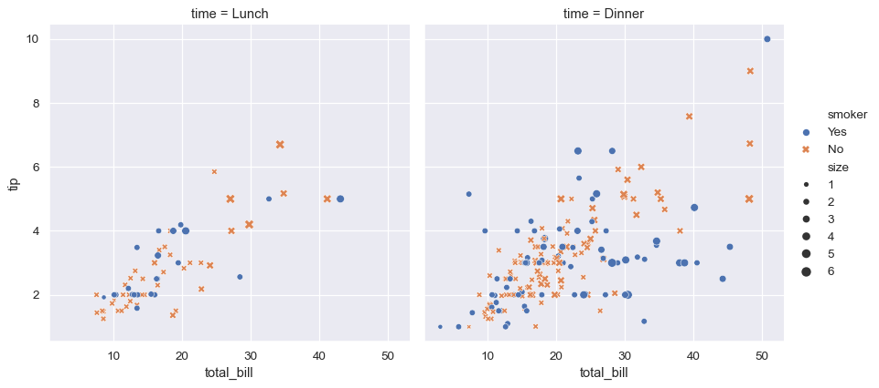

Slide 5
sns.set_theme()
This will affect how all matplotlib plots look, even if you don’t make them with seaborn.
Beyond the default theme, there are several other options, and you can independently control the style and scaling of the plot to quickly translate your work between presentation.
sns.set_theme(style="darkgrid")
"darkgrid" → Grid background (good for line plots).
"whitegrid" → Light grid (useful for statistical plots).
"dark" → Dark background, no grid.
"white" → Clean background.
"ticks" → Minimal style with axis ticks.

Slide 6
sns.relplot( data=tips, x="total_bill", y="tip", col="time", hue="smoker", style="smoker", size="size", )
Parameter Description
data=tips Uses the tips dataset (built-in in Seaborn).
x="total_bill" X-axis → Total bill amount.
y="tip" Y-axis → Tip amount.
col="time" Creates separate plots for Lunch & Dinner.
hue="smoker" Colors points based on whether the person is a smoker or not.
style="smoker" Uses different marker shapes for smokers/non-smokers.
size="size" Adjusts point size based on the size of the dining party.
Notes:
This plot shows the relationship between five variables in the tips dataset using a single call to the seaborn function relplot().
Notice how we provided only the names of the variables and their roles in the plot. Unlike when using matplotlib directly, it wasn’t necessary to specify attributes of the plot elements in terms of the color values or marker codes. Behind the scenes, seaborn handled the translation from values in the dataframe to arguments that matplotlib understands. This declarative approach lets you stay focused on the questions that you want to answer, rather than on the details of how to control matplotlib.

Slide 7
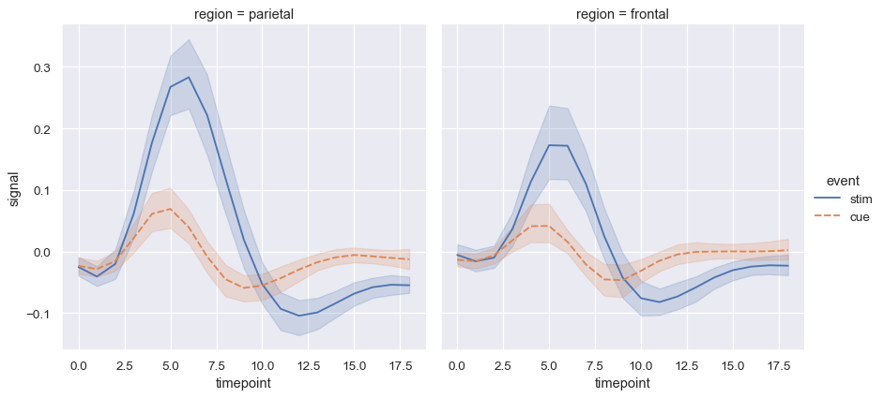
Statistical estimations
fmri = sns.load_dataset("fmri")
sns.relplot(data=fmri, kind="line", x="timepoint", y="signal", col="region", hue="event", style="event")

Slide 8
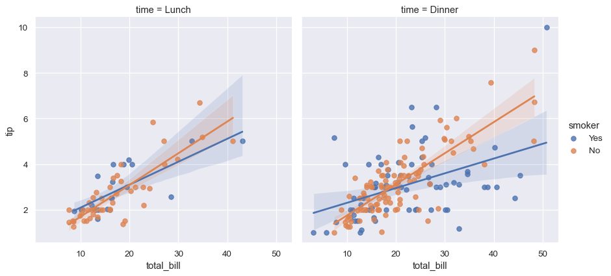
sns.lmplot(data=tips, x="total_bill", y="tip", col="time", hue="smoker")

Slide 9
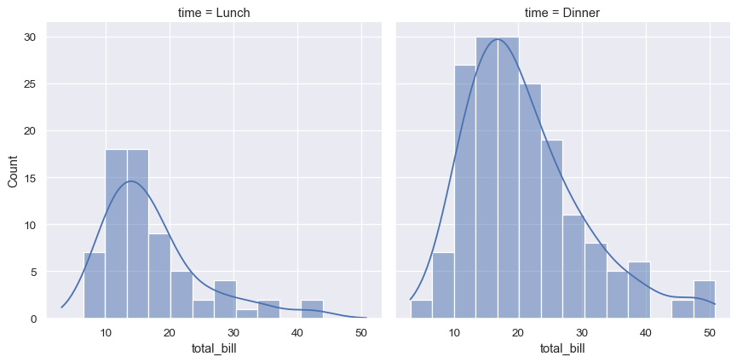
Distributional representations
Statistical analyses require knowledge about the distribution of variables in your dataset. The seaborn function displot() supports several approaches to visualizing distributions.
sns.displot(data=tips, x="total_bill", col="time", kde=True)

Slide 10
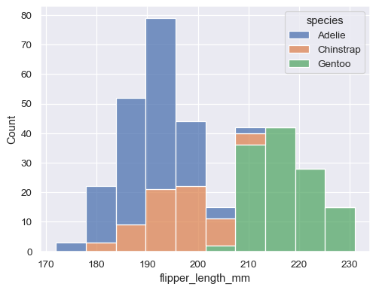
Sns.histplot()
penguins = sns.load_dataset("penguins")
sns.histplot(data=penguins, x="flipper_length_mm", hue="species", multiple="stack")

Slide 11
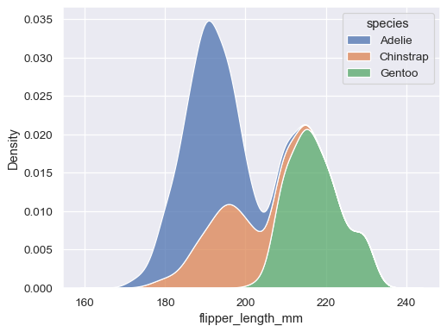
Kernel density plot
sns.kdeplot(data=penguins, x="flipper_length_mm", hue="species", multiple="stack")

Slide 12
Figure-level vs. axes-level functions
Axes-Level Functions
These functions work at the Matplotlib Axes level. They return a single Axes object, allowing direct Matplotlib customization.
sns.scatterplot()
sns.lineplot()
sns.histplot()
sns.boxplot()
Figure-Level Functions
These functions create an entire figure (not just one Axes). They use Seaborn’s built-in FacetGrid, which allows multi-plot visualization.
sns.relplot()
sns.catplot()
sns.displot()
sns.pairplot()

Slide 13
Seaborn: Accepted Data Structures
Seaborn supports multiple dataset formats, mainly from pandas, numpy, and Python built-ins (lists, dicts). Different structures impact how plots are created.
Format | Long-Form (Tidy Data) | Wide-Form
Structure | Each variable has its own column | Variables spread across multiple columns
Example | flights dataset (year, month, passengers) | Pivoted flights_wide (each month as a column)
Usage | More flexible, explicit variable assignment | Easier for simple plots
Customization | More intuitive for complex plots | Requires transformations for some visualizations

Slide 14
Object-Oriented API in seaborn
The seaborn.objects module introduces an Object-Oriented API (OO API) for building visualizations. Instead of using function-based methods like sns.scatterplot(), you create a Plot object and build the visualization step-by-step using method chaining.
import seaborn.objects as so
import seaborn as sns
penguins = sns.load_dataset("penguins")
so.Plot(penguins,x="bill_length_mm",y="bill_depth_mm").add(so.Dot())

Slide 15
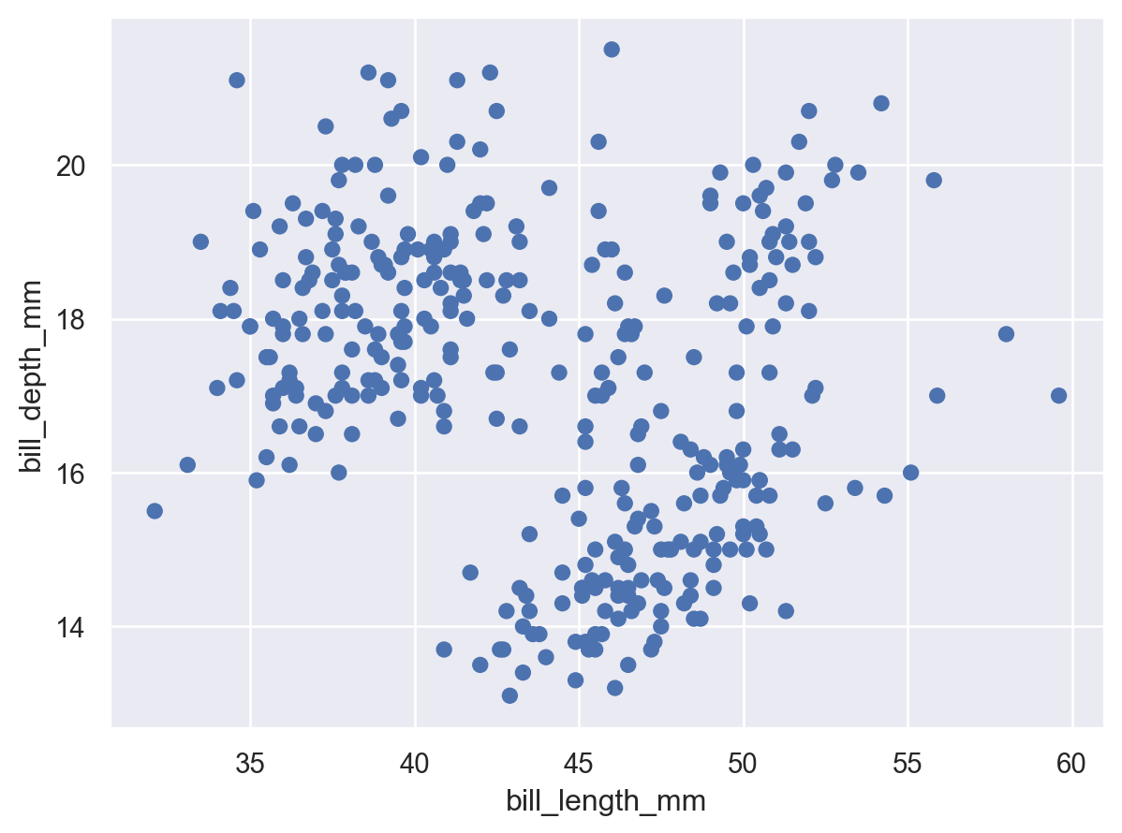

Slide 16
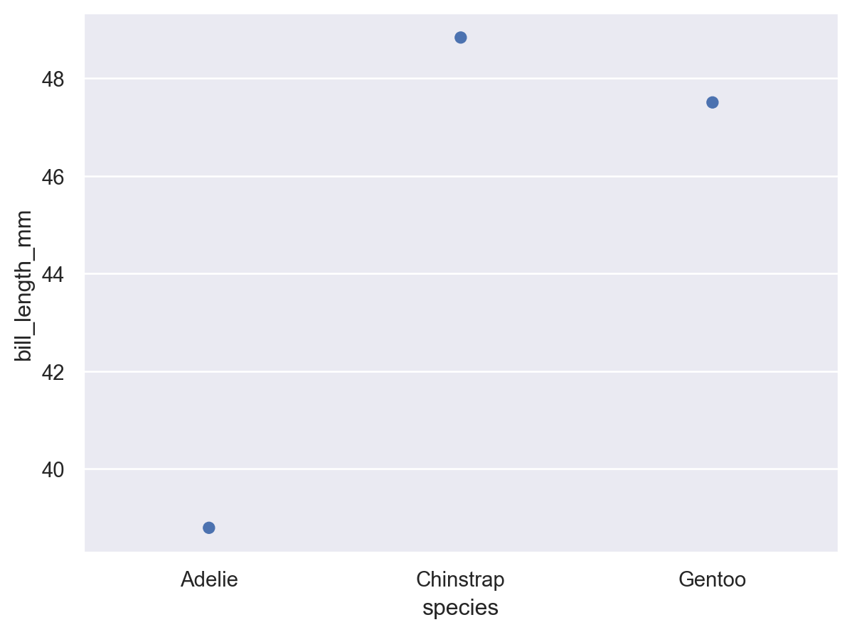

Slide 17
Customizing Colors & Aesthetics
Instead of hue= in function-based Seaborn, you map aesthetics explicitly.
so.Plot(penguins, x="bill_length_mm", y="bill_depth_mm", color="species").add(so.Dot()).scale(color={"Adelie": "red", "Chinstrap": "blue", "Gentoo": "green"})

Slide 18
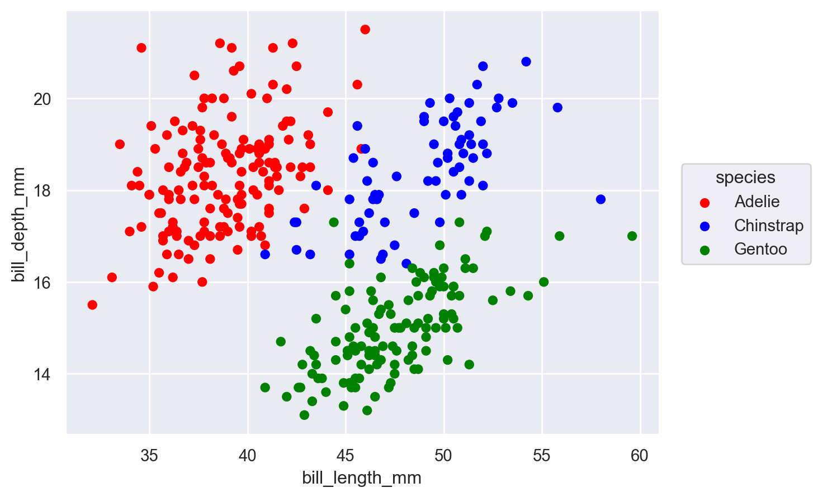

Slide 19
Faceting: Splitting into Multiple Plots
Instead of sns.FacetGrid(), you use .facet()
so.Plot(penguins, x="bill_length_mm", y="bill_depth_mm", color="species").facet(col="sex").add(so.Dot())

Slide 20
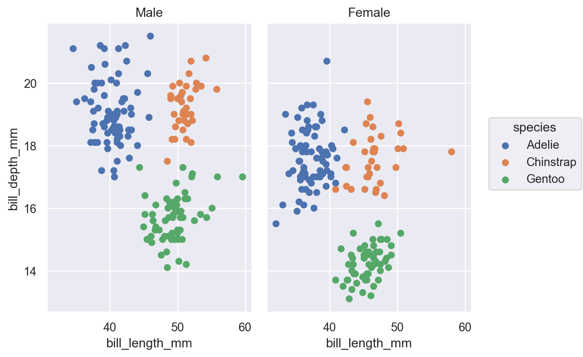

Slide 21
Available markers
Function-based Seaborn | Object-Oriented Equivalent
sns.scatterplot() | .add(so.Dot())
sns.histplot() | .add(so.Bars())
sns.lineplot() | .add(so.Line())
sns.boxplot() | .add(so.Box())
sns.violinplot() | .add(so.Violin())

Slide 22
Visualizing Statistical Relationships in Seaborn
Seaborn provides powerful tools to visualize statistical relationships between variables using scatter plots and line plots. The key function for this is sns.relplot(), which acts as a figure-level function that wraps:
sns.scatterplot() (when kind="scatter", default)
sns.lineplot() (when kind="line")
import seaborn as sns
import matplotlib.pyplot as plt
# Load dataset
tips = sns.load_dataset("tips")
# Basic scatter plot
sns.relplot(data=tips, x="total_bill", y="tip")
plt.show()

Slide 23
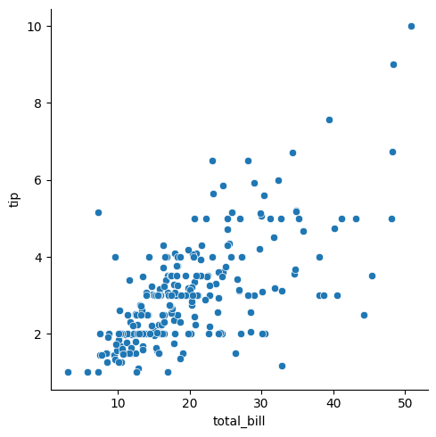

Slide 24
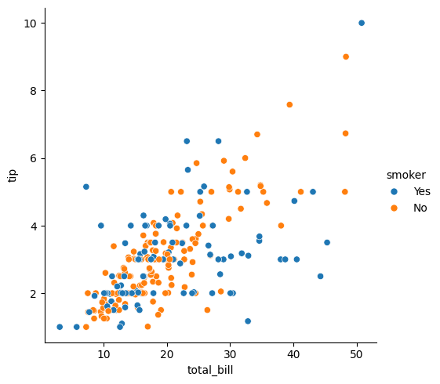
sns.relplot(data=tips, x="total_bill", y="tip", hue="smoker")

Slide 25

sns.relplot(data=tips, x="total_bill", y="tip", hue="smoker", style="smoker")

Slide 26
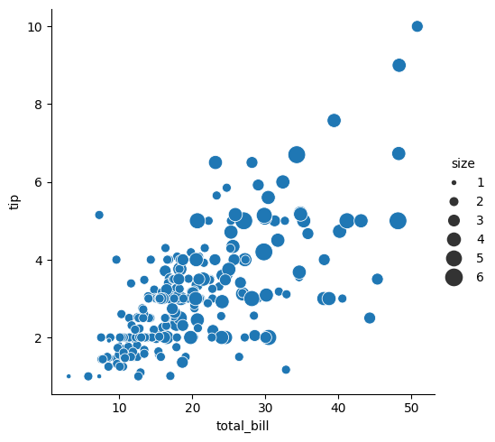
sns.relplot(data=tips, x="total_bill", y="tip", size="size", sizes=(15, 200))

Slide 27
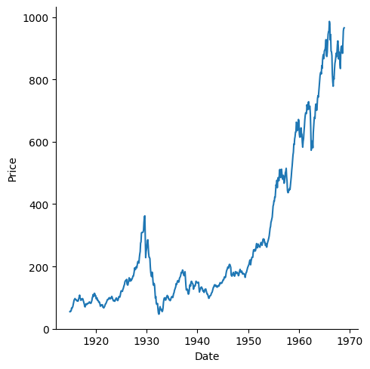
Line plot – Dow jones
sns.relplot(data=dowjones, x="Date", y="Price", kind="line")

Slide 28
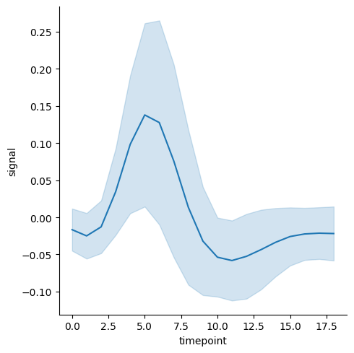
Adding Confidence Intervals
fmri = sns.load_dataset("fmri")
sns.relplot(data=fmri, x="timepoint", y="signal", kind="line", errorbar="sd")

Slide 29
Multi-Plot (Facet) Approach
Instead of using hue, size, or style, we can split data into subplots.
sns.relplot(data=tips, x="total_bill", y="tip", hue="smoker", col="time")

Slide 30
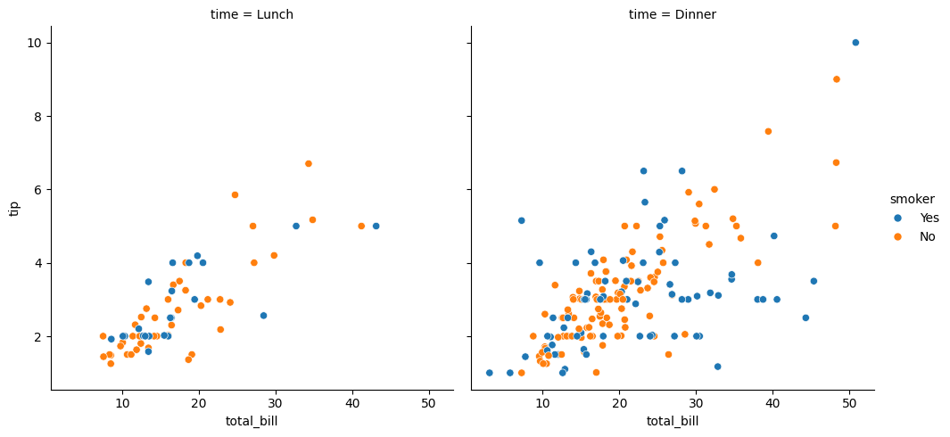

Slide 31
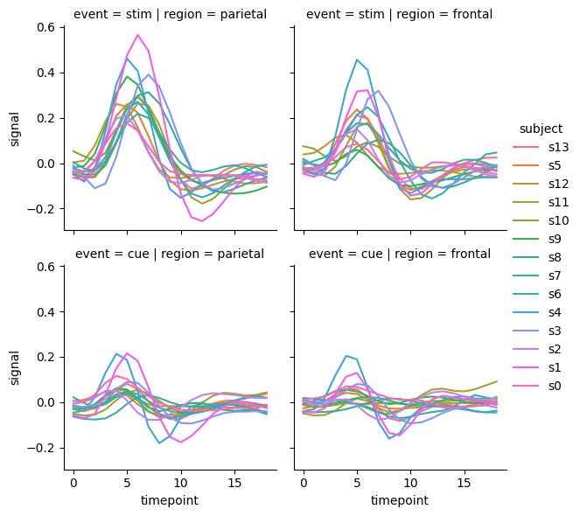
sns.relplot(data=fmri, kind="line", x="timepoint", y="signal", hue="subject", col="region", row="event", height=3, estimator=None)

Slide 32
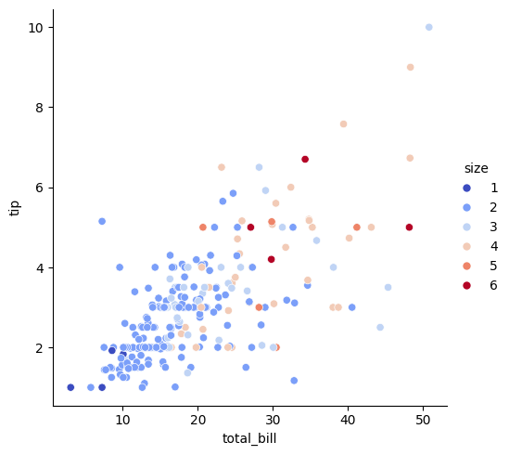
Customising colors
sns.relplot(data=tips, x="total_bill", y="tip", hue="size", palette="coolwarm")

Slide 33
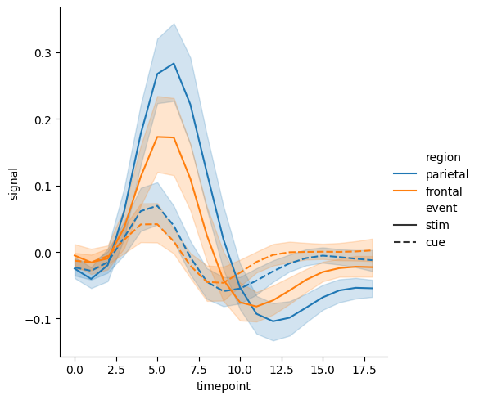
Change Line Style (style)
sns.relplot(data=fmri, kind="line", x="timepoint", y="signal", hue="region", style="event")

Slide 34
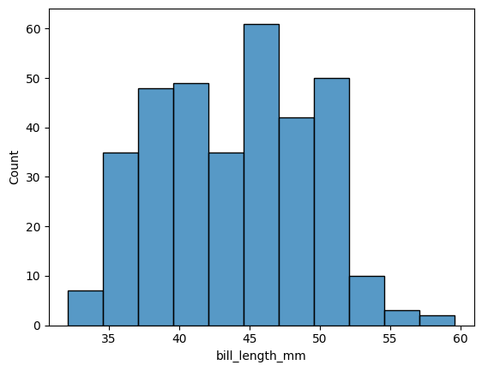
Basic histogram

Slide 35
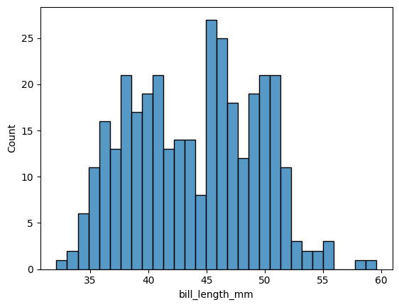
Customizing the Histogram (Adjusting Bin Size)
sns.histplot(penguins, x="bill_length_mm", bins=30)

Slide 36
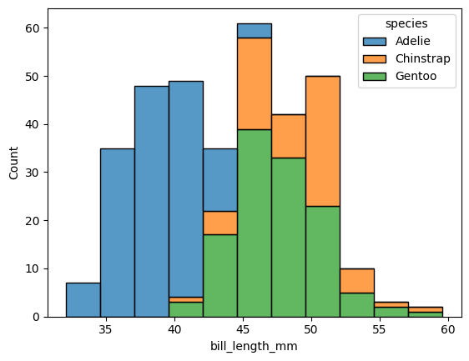
sns.histplot(penguins, x="bill_length_mm", hue="species", multiple="stack")

Slide 37
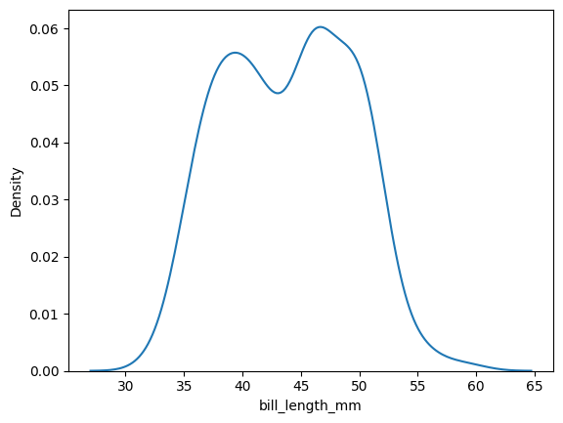
Density plot
sns.kdeplot(penguins, x="bill_length_mm")

Slide 38
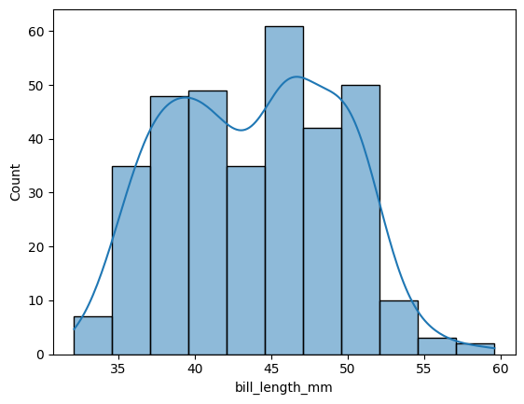
KDE + Histogram Together
sns.histplot(penguins, x="bill_length_mm", kde=True)

Slide 39
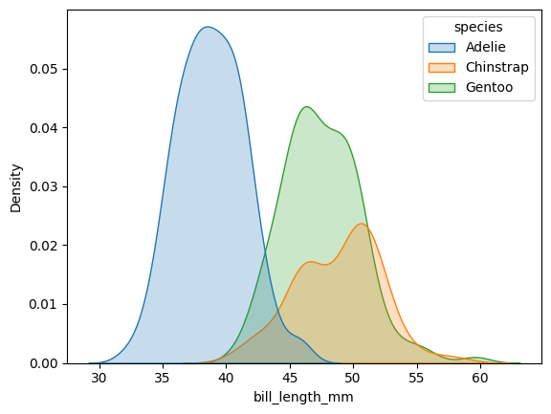
Kde by category
sns.kdeplot(penguins, x="bill_length_mm", hue="species", fill=True)

Slide 40
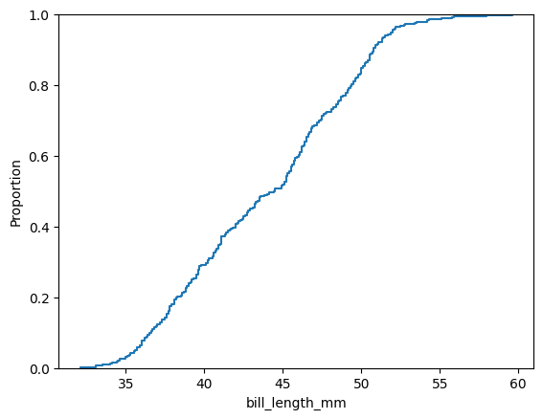
ECDF
sns.ecdfplot(penguins, x="bill_length_mm")

Slide 41
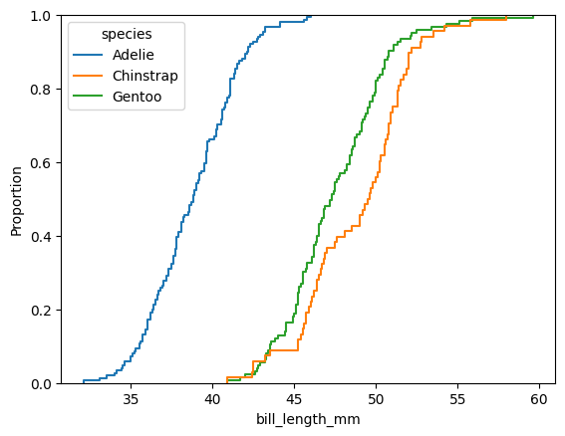
ECDF with Hue
sns.ecdfplot(penguins, x="bill_length_mm", hue="species")

Slide 42
Categorical Plot Types in Seaborn
Category | Plot Type | Function
Scatter-Based | Strip Plot | sns.stripplot()
 | Swarm Plot | sns.swarmplot()
Distribution-Based | Box Plot | sns.boxplot()
 | Violin Plot | sns.violinplot()
 | Boxen Plot | sns.boxenplot()
Estimate-Based | Bar Plot | sns.barplot()
 | Count Plot | sns.countplot()
 | Point Plot | sns.pointplot()

Slide 43
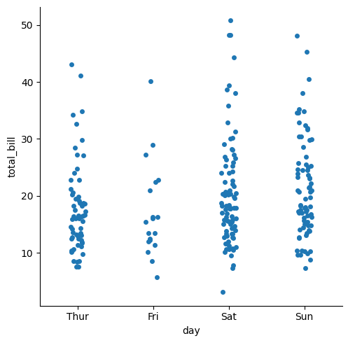
Strip Plot
import seaborn as sns
import matplotlib.pyplot as plt
# Load dataset
tips = sns.load_dataset("tips")
# Basic strip plot
sns.catplot(data=tips, x="day", y="total_bill", kind="strip", jitter=True)
plt.show()

Slide 44
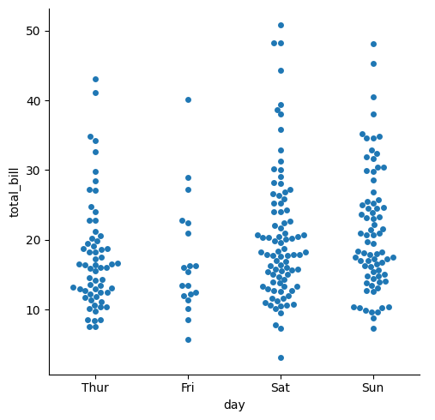
Swarm Plot (swarmplot())
sns.catplot(data=tips, x="day", y="total_bill", kind="swarm")

Slide 45
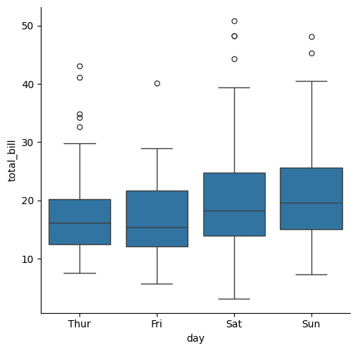
boxplot
sns.catplot(data=tips, x="day", y="total_bill", kind="box")

Slide 46
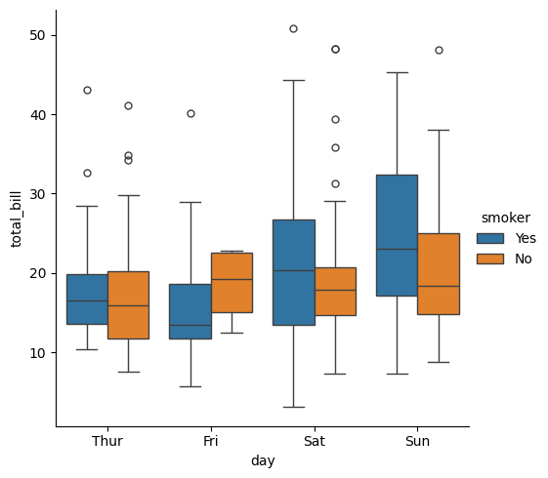
Adjusting hue
sns.catplot(data=tips, x="day", y="total_bill", hue="smoker", kind="box")

Slide 47
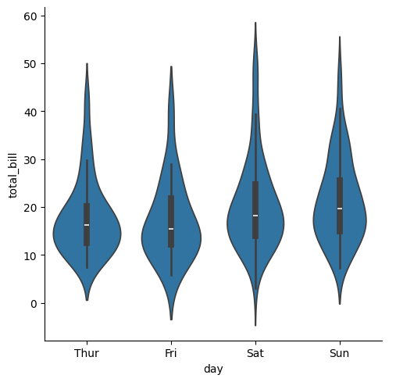
Violin Plot – combines boxplot with kde estimates
sns.catplot(data=tips, x="day", y="total_bill", kind="violin")

Slide 48
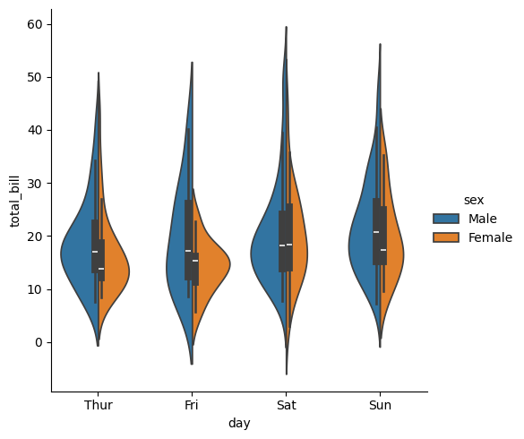
sns.catplot(data=tips, x="day", y="total_bill", hue="sex", kind="violin", split=True)

Slide 49
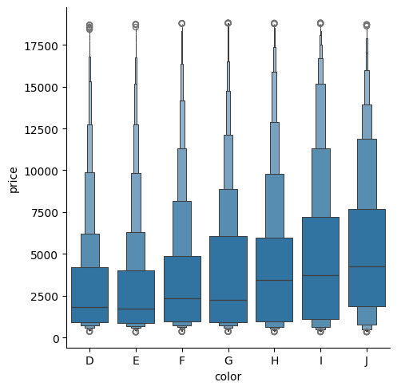
Boxen plot - A box plot alternative for large datasets
sns.catplot(data=diamonds, x="color", y="price", kind="boxen")

Slide 50
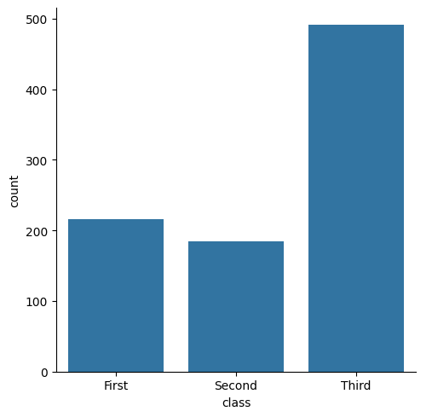
count Plot
sns.catplot(data=titanic, x="class", kind="count")

Slide 51
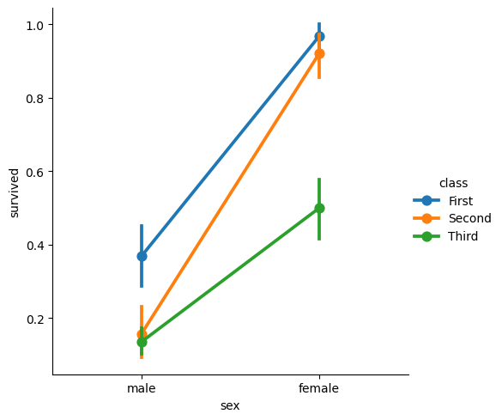
Point plot
sns.catplot(data=titanic, x="sex", y="survived", hue="class", kind="point")

